Slide 1

NI Center of Excellence
Building Strong, Confident, and Innovative Teams
Notes:
Over the last 30+ years, National Instruments has worked closely with thousands of companies around the world from dozens of industries. We have observed certain key elements that make some teams more successful that other teams. We have studied those elements and documented them in a program we call the NI Center of Excellence.

Slide 2


Types of Proficiency
INDIVIDUAL
ORGANIZATIONAL (TEAMS)
Training Courses
Online Content
Badge Program
On-the-Job Training
User Groups
Coaching and Mentoring
Notes:
NI has great programs to teach what we call individual proficiency – the skills and concepts that an individual needs to be successful. For a LabVIEW project, this might include how to create and use a While Loop, or how to build an application, or how to properly use the attributes of a front panel control. There are many great resources available to teach these skills, including instructor-led training, online training, and our new badge program. These may lead someone to become a Certified LabVIEW Architect.
But we have observed teams where this individual proficiency is not enough. Hiring two CLAs and putting them on the same project does not guarantee that they will be successful together. For example, one may use Object-Oriented Programming and the other may not; making code difficult to maintain between the two developers.
So we set out to understand what makes some groups successful, and what keeps other groups from reaching success.

Slide 3
Components of Organizational Proficiency
Standard Libraries and Templates
Code Management
Design and Code Reviews
Software Testing and Release
Requirements Gathering and Tracking
Internal User Group
External and Global Community
Organizational Proficiency Plan
Learning and Development Plan
Internal Onboarding
Designated Technical Lead
Development Environment and Core Concepts
Developer Mastery
Architecture Mastery
Software Deployment and Distribution
Engineer Good Software
Engage in Community Learning
Ensure Technical Leadership
Notes:
For more than 5 years, we studied effective groups at companies that had the highest results. We looked for common practices at those companies to understand what do the best companies do differently.
The result is this list of 15 best practice areas. Each area on this list represents a set of best practices that we’ve observed at companies that had groups performing in strong, productive ways. We’ve tried to document what they do and we have collected this information under one program that we call the Center of Excellence.
We created a self-assessment that any group can use to assess where they are today, and then set a plan to implement these best practices to improve their teams. That assessment is available online at ni.com/center_of_excellence.
After you complete the assessment, you’ll see what needs improved. You’ll need to ask what to do next. We’ve also studied the order that these practices work.

Slide 4
Center of Excellence
START HERE
1
Designated Technical Lead
2
Internal User Group
3
External and Global Community
Standard Libraries and Templates
Code Management
Design and Code Reviews
Software Testing and Release
Requirements Gathering and Tracking
BUILD PROFICIENT PRACTICES
1
Standard Libraries and Templates
2
Code Management
3
Design and Code Reviews
4
Organizational Proficiency Plan
5
Learning and Development Plan
Internal User Group
External and Global Community
Organizational Proficiency Plan
Learning and Development Plan
6
Internal Onboarding
Internal Onboarding
ESTABLISH BEST PRACTICES
Designated Technical Lead
1
Development Environment and Core Concepts
2
Developer Mastery
3
Architecture Mastery
4
Software Deployment and Distribution
5
Software Testing and Release
Development Environment and Core Concepts
Developer Mastery
Architecture Mastery
Software Deployment and Distribution
6
Requirements Gathering and Tracking
Engineer Good Software
Engage in Community Learning
Ensure Technical Leadership
Notes:
We observed that the best groups implement these practices in specific order.
First, someone needs to be in charge of the program. That’s your technical lead. That person needs to be empowered and motivated to enact change in the organization. Then, the technical lead establishes an internal user group meeting. This gives him the forum in which to discuss the rest of the program. The technical lead then connects to the external community in online forums, events like CLA Summits, and conferences like NIWeek. This gives the technical lead insight into how other companies implement these best practices.
Then, the technical lead manages the creation of standard libraries and templates, including a style guide for the group. This includes what products they will use, what architectures they will follow, and how they will modularize their code. Then the lead sets up a code management system to ensure that everyone has access to a shared version of the templates, and they follow best practices for managing their own code. Then the lead sets up and models code reviews. Code reviews help programmers learn and adopt the company standards. This is finally when it makes sense to create a plan for proficiency at the account, including the desired proficiency levels of engineers in the group. This leads to a learning and development plan that guides investment in training activities. The lead then creates an onboarding plan to bring new employees up to speed as fast as possible.
Once this foundation is built, the technical lead focuses on improving the proficiency level of the team, from core concepts, to development, to architecture. The lead then ensures the team is stilled in software deployment, software testing, and requirements gathering.

Slide 5
Center of Excellence
Non animated version
START HERE
1
Designated Technical Lead
2
Internal User Group
3
External and Global Community
BUILD PROFICIENT PRACTICES
1
Standard Libraries and Templates
2
Code Management
3
Design and Code Reviews
4
Organizational Proficiency Plan
5
Learning and Development Plan
6
Internal Onboarding
ESTABLISH BEST PRACTICES
1
Development Environment and Core Concepts
2
Developer Mastery
3
Architecture Mastery
4
Software Deployment and Distribution
5
Software Testing and Release
6
Requirements Gathering and Tracking
Engineer Good Software
Engage in Community Learning
Ensure Technical Leadership

Slide 6

1
2
3
4
Perform Internal Assessment
Download from ni.com/ center_of_excellence
Implement Best Practices
Use Online Guides
Hire Coaching Experts
Perform Formal Audit
Hire Certified Auditor
Earn Recognition
Receive Center of Excellence Certification
Notes:
The simplified view of the full Center of Excellence process looks like this. The team performs an internal self-assessment, then works to improve in the gap areas. Once the team feels they have implemented all of the best practices, they can ask for a formal audit from National instruments. NI will send an auditor to review the processes and provide feedback to the team. If the team passes the audit, they qualify for recognition as a certified Center of Excellence.

Slide 7
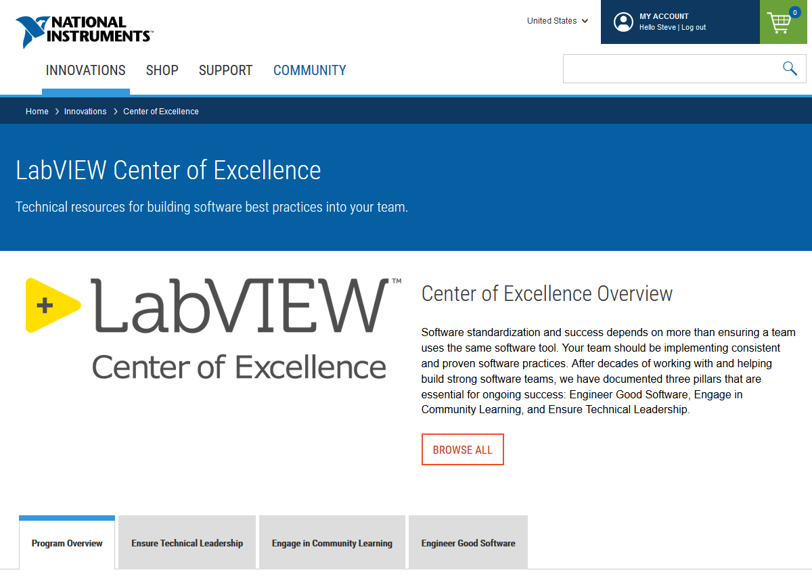
Self-Serve: Center of Excellence Learning Portal
Includes great resources for coaches
Notes:
All of the information needed to follow this process is posted at ni.com/center_of_excellence. Start with the program overview, then browse into the other 3 tabs to find content on each of the best practice areas.

Slide 8
How to implement the program
The following slides outline the steps to implement the program.

Slide 9
1
Perform Internal Assessment Download from ni.com/center_of_excellence.
Topic |  | Goal |  | Actions/Details | Timeframe
Engineer Good Software | Requirements Gathering and Tracking | R | Processes for gathering, tracking and managing requirements exist |  | Started
 |  | O | Change cost estimation and sign off processes exist
 | Design Reviews | R | Team conducts iterative design reviews for all projects and has a process for capturing and resolving issues found |  | Incomplete
 |  | O | None
 | Code Reviews | R | A style guide is used for code development and a code review process exists which makes use of VI Analyser |  | Incomplete
 |  | O | Team specific additions have been made to the NI Style Guide and VI Analyser test suite
 | Standard (Reuse) Libraries and Templates | R | Opportunities for reuse are identified developed and maintained. Technical lead defines and executes tasks for automating |  | Complete
 |  | O | The team style guide includes a section which details how the team will document code and deliverables
 | Code Management (Source Code Control) | R | Team has selected an SCC solution, and determined a plan to implement it (structure/commit cadence/resolving conflicts) |  | Started
 |  | O | None
 | Software Testing and Release | R | Team has a test plan which is implemented, and is automated where it is feasible |  | Started
 |  | O | Testing processes and code exist for project and reuse code – unit testing, integration testing and DETT procedure
Engage in Continuous Community Learning | Organisational Proficiency Plan | R | Team drafts and executes yearly proficiency plan – includes topics not sufficiently covered by NI training and team specific processes |  | Incomplete
 |  | O | Team conducts yearly skills assessment
 | Internal Onboarding | R | Internal training bridges the gap between NI training and productivity on the company LV team. Processes under “Engineer Good Software” are clearly documented |  | Complete
 |  | O | A process exists to confirm that the new individual is ready to effectively contribute to the code base
 | Internal User Group/Mentoring Program | R | Meetings are conducted at least 6 times per year and agenda’s are driven by a designated individual |  | Incomplete
 |  | O | None
 | Learning and Development Plan | R | Team has a training and certification plan for designated individuals and demonstrates execution of the plan |  | Started
 |  | O | None
 | External and Global Community | R | Designated individuals attend regional user groups and NI events (NI Week, NI Days, Developer Days) |  | Started
 |  | O | Designated individuals engage in the forums or monitor relevant discussions
Ensure Technical Knowledge | Designated Technical Lead | R | Individual(s) have been designated to be the technical lead and to drive software process standards |  | Incomplete
 |  | O | Attaining CLA is part of the employees yearly review
 | Development Environment and Core Concepts | R | Specific roles/team members who only need Core 1-2 understanding are identified, process for proving has been understanding identified and team members have proven such understanding |  | Complete
 |  | O | None
 | CLD Mastery | R | Two individuals have attached CLD, team has determined who else needs a CLD skill set |  | Complete
 |  | O | None
 | Architecture Mastery | R | Designated technical lead has attached a CLA. Existing code has been reviewed by external coach, team has a process for managing/documenting changes and the ability to tackle them |  | Incomplete
 |  | O | Team is using the best solution for the application
 | Software Deployment and Distribution | R | Team has determined and is using an effective deployment/distribution strategy and defined a regular cadence for builds |  | Incomplete
 |  | O | The team has automated the build process
Notes:
The self-assessment is an Excel sheet with questions that will guide a team to understand how well they stack up to best-in-class companies. The result will be a list of gaps that need to be addressed.

Slide 10
2
Implement Best Practices Use Online Guides
Hire Coaching Experts
✓
✓
✓
✓
✓
Standard Libraries and Templates
Code Management
Design and Code Reviews
Software Testing and Release
Requirements Gathering and Tracking
✓
✓
✓
✓
✓
Internal User Group
External and Global Community
Organizational Proficiency Plan
Learning and Development Plan
Internal Onboarding
✓
✓
✓
✓
✓
Designated Technical Lead
Development Environment and Core Concepts
Developer Mastery
Architecture Mastery
Software Deployment and Distribution
Engineer Good Software
Engage in Community Learning
Ensure Technical Leadership
Notes:
Using the materials online at ni.com/center_of_excellence a team can work to improve in each area, following the order described earlier.
If your team struggles to implement any area, we can recommend Alliance Partners who are experts in these areas. They may be available to consult your company in some of these areas.

Slide 11
3
Perform Formal Audit Hire Certified Auditor
Topic |  | Goal |  | Actions/Details | Timeframe
Engineer Good Software | Requirements Gathering and Tracking | R | Processes for gathering, tracking and managing requirements exist | None | Complete
 |  | O | Change cost estimation and sign off processes exist
 | Design Reviews | R | Team conducts iterative design reviews for all projects and has a process for capturing and resolving issues found | None | Complete
 |  | O | None
 | Code Reviews | R | A style guide is used for code development and a code review process exists which makes use of VI Analyser | None | Complete
 |  | O | Team specific additions have been made to the NI Style Guide and VI Analyser test suite
 | Standard (Reuse) Libraries and Templates | R | Opportunities for reuse are identified developed and maintained. Technical lead defines and executes tasks for automating | None | Complete
 |  | O | The team style guide includes a section which details how the team will document code and deliverables
 | Code Management (Source Code Control) | R | Team has selected an SCC solution, and determined a plan to implement it (structure/commit cadence/resolving conflicts) | None | Complete
 |  | O | None
 | Software Testing and Release | R | Team has a test plan which is implemented, and is automated where it is feasible | None | Complete
 |  | O | Testing processes and code exist for project and reuse code – unit testing, integration testing and DETT procedure
Engage in Continuous Community Learning | Organisational Proficiency Plan | R | Team drafts and executes yearly proficiency plan – includes topics not sufficiently covered by NI training and team specific processes | None | Complete
 |  | O | Team conducts yearly skills assessment
 | Internal Onboarding | R | Internal training bridges the gap between NI training and productivity on the company LV team. Processes under “Engineer Good Software” are clearly documented | None | Complete
 |  | O | A process exists to confirm that the new individual is ready to effectively contribute to the code base
 | Internal User Group/Mentoring Program | R | Meetings are conducted at least 6 times per year and agenda’s are driven by a designated individual | None | Complete
 |  | O | None
 | Learning and Development Plan | R | Team has a training and certification plan for designated individuals and demonstrates execution of the plan | None | Complete
 |  | O | None
 | External and Global Community | R | Designated individuals attend regional user groups and NI events (NI Week, NI Days, Developer Days) | None | Complete
 |  | O | Designated individuals engage in the forums or monitor relevant discussions
Ensure Technical Knowledge | Designated Technical Lead | R | Individual(s) have been designated to be the technical lead and to drive software process standards | None | Complete
 |  | O | Attaining CLA is part of the employees yearly review
 | Development Environment and Core Concepts | R | Specific roles/team members who only need Core 1-2 understanding are identified, process for proving has been understanding identified and team members have proven such understanding | None | Complete
 |  | O | None
 | CLD Mastery | R | Two individuals have attached CLD, team has determined who else needs a CLD skill set | None | Complete
 |  | O | None
 | Architecture Mastery | R | Designated technical lead has attached a CLA. Existing code has been reviewed by external coach, team has a process for managing/documenting changes and the ability to tackle them | None | Complete
 |  | O | Team is using the best solution for the application
 | Software Deployment and Distribution | R | Team has determined and is using an effective deployment/distribution strategy and defined a regular cadence for builds | None | Complete
 |  | O | The team has automated the build process
Notes:
Once your team has implemented all of the best practice areas, NI can send an auditor to assess the processes on your team. This will lead to additional feedback, or to official recognition in the program.

Slide 12
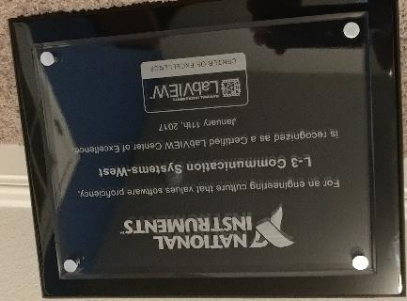
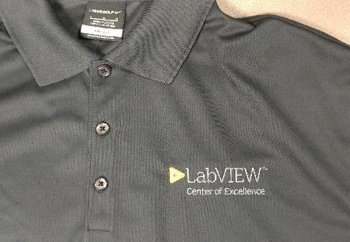

4
Earn Recognition Receive Center of Excellence Certification
Notes:
If your team passes the audit, we will present a plaque and shirt to your team. This recognition becomes a powerful way to establish your team as the experts in the company.

Slide 13
Notes:
If you would like additional information about the program, please study the materials at ni.com/center_of_excellence, or contact your local sales team to set up a discussion.

